Slide 1

GENERAL DATA PROTECTION REGULATION (GDPR)
PANEL DISCUSSION
ARMA New Jersey
November 15, 2017

Slide 2
Our Panel
BILL SAFFADY
MA, MSLS, PhD
LINDA RUSH
CIPP/US/C, CIPM, FIP
CHRIS WILLIAMS
C|CISO, CRISC, CISM

Slide 3
GDPR: Some Key Points
William Saffady
www.saffady.com
Email: wsaffady@saffady.com

Slide 4
GDPR Background
Approved by EU Parliament in April 2016 to take effect on May 25, 2018
Standardizes protection of personal data across EU member states
Replaces national transpositions of EU Data Protection Directive 95/46/EC
Does not require enabling legislation by national governments
In force immediately in EU member states on specified date
Scope is limited to processing of personal data -- criminal history data, anonymous data, pseudonymous data excluded
Applies to personal data in electronic and non-electronic form

Slide 5
What is Personal Data?
Somewhat broader definition than Directive 95/46/EC
Any information relating to an identified or identifiable natural person—the data subject
Includes names and numeric identifiers
Encompasses physical, physiological, genetic, mental, economic, cultural, or social identity
Includes location data and online identifiers
“Sensitive” personal data reveals racial or ethnic origin, political opinions, religious or philosophical beliefs, trade-union membership, data about sexual orientation, genetic data, biometric data

Slide 6
Who is subject to the GDPR?
Organizations established in an EU member state that process personal data, regardless of where the processing occurs
Organizations established outside the EU that process personal data of EU residents when offering them goods or services for a fee or free
Organizations established outside the EU that process personal data to monitor the behavior of EU residents – for example, to profile individuals, possibly to track web activity
Data controller vs. data processor

Slide 7
Data protection principles
Transparent processing of personal data limited to stated purpose
Personal data collection and processing limited to the minimum necessary for stated purpose
Personal data must be accurate and up to date
Personal data not retained longer than necessary for intended purpose
Personal data must be protected against unauthorized processing, loss, destruction, damage
Privacy by design: data protection to be considered at outset of system design not as an addition
Data controller is accountable for compliance

Slide 8
Rights of Data Subject
Access to basic information about data controller, reasons for processing personal data
Access to information about categories of data being processed, recipients with whom data is shared, retention period for data
Right to erasure of personal data no longer needed for original purpose
Right to rectify inaccurate or incomplete personal data
Right to object to or restrict processing of inaccurate data or in other circumstances
Right to receive a copy of personal data in commonly used format

Slide 9
Cross-Border Data Transfers Permitted
Within European Economic Area
To other countries with adequate level of protection
Within corporate group based on binding corporate rules
Based on contractual clauses that ensure protection
With explicit consent of data subject having been informed of possible risk of transfer
When necessary to fulfill a contract between data controller and data subject
In the public interest or vital interest of the data subject
To establish, exercise, or defend legal claims

Slide 10
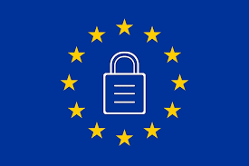
What is the Global Data Protection Regulation (GDPR)?
Landmark legislation with ambitious goals
Primary objectives
  Give individuals back the control of their personal data
  Simplify the regulatory environment for international business by unifying the regulation within the EU
Regulation is legal requirement applies to all Member States of the EU
Extra-territorial reach - Impacts all organizations that collect, receive, or process personal data of data subjects from the European Economic Area regardless of company location
  Significant fines and private rights of action for violations
  Up to 4% of global annual turnover (revenue)
COMPLIANCE BY MAY 25, 2018

Slide 11
Key Highlights of GDPR
Greater data processor obligations/accountability
Expands scope of personal data
  genetic & biometric data; online identifiers such as IP addresses, cookie identifiers, and radio frequency identification tags; geolocation data)
Data Minimization
Consent - explicit freely-given – not implied or forced
Privacy by Design
Use of Privacy Impact Assessments (PIA/DPIAs)
Data breach notification obligations – 72 hours
Appointment of Data Privacy Officer (DPO) – internal or external
Children – parental consent for children under 13; Member States discretion for ages 13-15
Right to be Forgotten/Right of Erasure

Slide 12
Important Concepts Under the GDPR for Record Managers
Territorial Scope – Includes processing of personal data as a controller or processor in the EU and processing of personal data outside the EU of a data subject in the EU
  Location of processing activities
  Types of records – use and storage
Data Minimization – Data collection shall be “adequate, relevant and not excessive in relation to the purpose for which it is processed”
  collect and hold only minimum amount of personal data needed to fulfill purpose
  time limits for erasure/disposal
  Unstructured Data (files shares, cloud, SharePoint, pst)
  BYOD
  Paper records
  Third Party Vendors

Slide 13
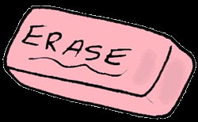
Important Concepts Under the GDPR for Record Managers
Accountability - documenting how the company complies with GDPR - comprehensive governance measures (e.g. data mapping/data flows; audits)
Pseudonymization/Anonymization
  Pseudonymization – replacing personal attribute with an unique attribute in a record; natural person still likely to be identified indirectly (hashing, encryption, tokenization, etc.)
  Anonymization – data can not be used to identify a natural person taking into account all the means likely reasonably to be used by controller or third party
Right to be Forgotten – right for consumers to require erasure of personal data
  Legal obligations
  Litigation holds
  Competing legislation

Slide 14
Creation of New Records
Expanded Definition of Personal Data - Expanded Concept of Personal Data
Consents – Tracking express consents
Privacy Impact Assessments – Data Controllers are required to conduct PIA for “high risk” data processing
Privacy by Design – Implement appropriate technical and organizational measures to support data privacy and protect data subjects
Accountability/Governance – comprehensive governance measures; audits of processes
Data Subject Rights – Access, Right to be Forgotten, Portability

Slide 15
What do you need to do?
What records does company have?
  Understand what personal data records the company has
Where are the personal data records that my company has?
  Knowledge of data mapping/data flows; allows for data classification
Retention Policy/Schedule
  Review and update policy and retention schedules to reflect new record classes
  Review and update retention schedules to reflect data minimization requirements
  Update policy to address right to be forgotten and exceptions
Train
  Employees need to know and understand new policies
Audit
  Ensure policies are being enforced and followed

Slide 16
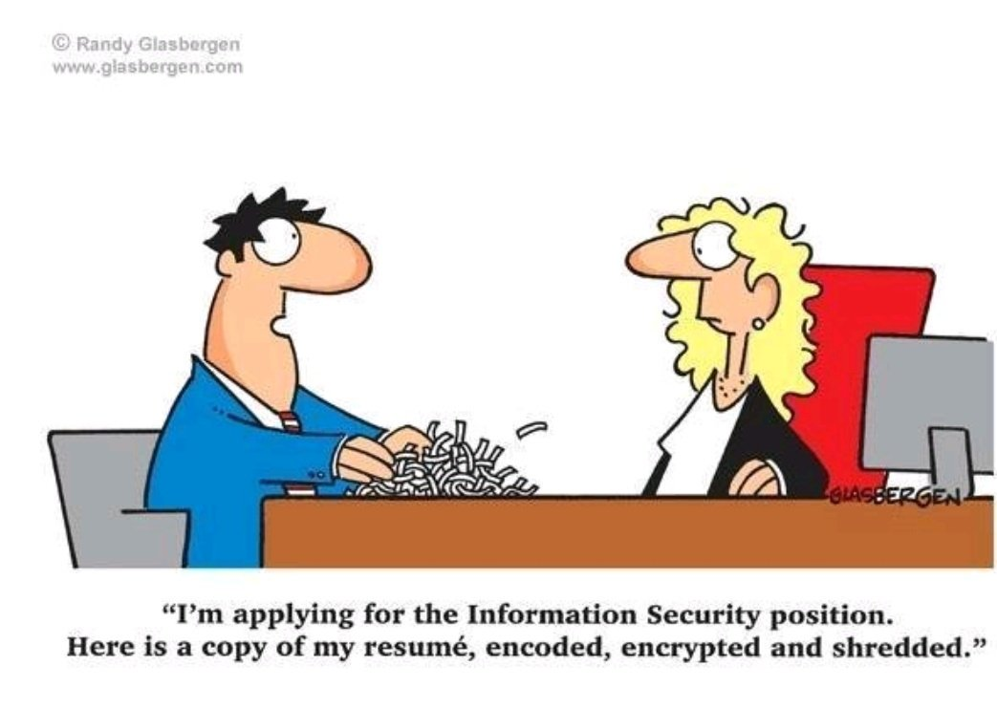

Slide 17
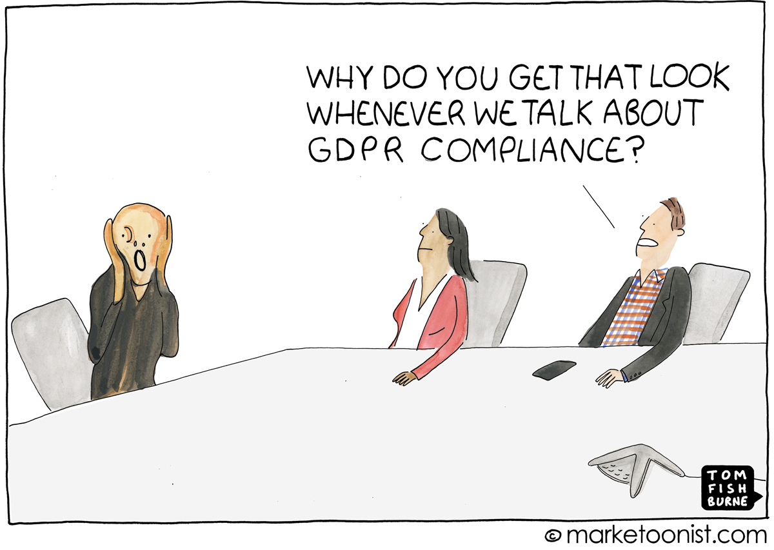

Slide 18
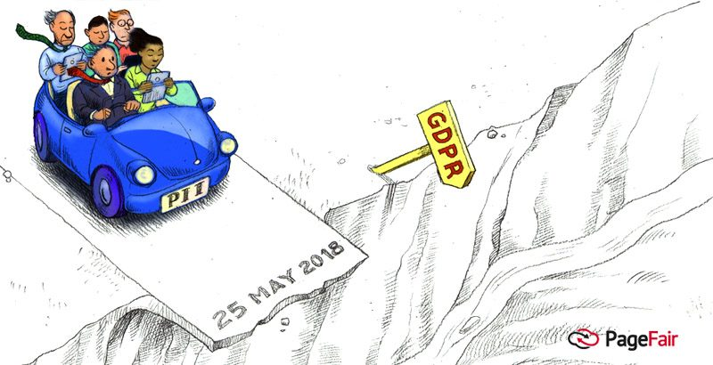

Slide 19
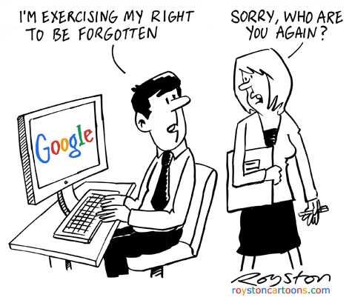

Slide 20

Does it apply to your organization?
EU offices/subsidiaries that - receive, transmit, use, process
personal data
Offer services or goods to – organizations or individuals
in the EU
Monitor behavior
of - individuals
in the EU
Yes
Notes:
Does your business have offices, subsidiaries or other types of establishments in the EU that collects, receives, transmits, uses, stores or otherwise processes personal data?
(Processing may take place outside of EU)

Slide 21








Data Protection Model
Assess Data Processes
Data Classification
Identify users with access to in-scope personal data.
Evaluate policies & security controls
Assess risks to data subjects
Breach
Prevention
Restrict access to in-scope personal data
Implement and document security controls to show compliance
Manage personal data lifecycle
Data identified as in-scope
Detection
&
Response
Monitor access to personal data.
Actively detect and remediate security threats
Implement incident management & response capabilities
Data
Subjects
Management of data subject’s rights including right to be forgotten and right to portability.
Provide independent dispute resolution mechanism for EU data subjects

Slide 22

Compliance Strategy
Assess Risks & Generate Awareness
Assess Risks and Generate Awareness
Perform Data Discovery/Inventory & Data Flow Analysis
Conduct Risk Assessments & Identify Gaps
Develop Supporting Policies, Procedures and Processes
Employee Security Awareness and Training
Design & Implement Controls
Design and Implement Operational Controls
Obtain & Maintain Consent for Data Subjects | Consent Lifecycle Management
Data Transfers & Third-Party Vendor/Partner Management
Data Subject’s Data Protection Rights
Administrative, Technical & Physical Safeguards
2
Manage & Maintain Controls
Manage and Maintain Effective Controls
Perform Privacy Impact Assessments (PIAs)
Data Lifecycle Management | Access, Retention & Erasure
Maintain Data Confidentiality,
Integrity, Availability, Access & Resilience
Breach Monitoring & Notification | Incident Management
Audit/Compliance Reporting | Internal & External
Maintain Privacy Policy/Notice
Provide Independent Dispute Resolution Mechanism for EU data subjects
Ongoing Compliance & Adherence
Demonstrate Ongoing Compliance and adherence
Ongoing Evaluation of Policies, Control and Process Effectiveness

Slide 23

Complimentary Assessment
https://PerpetuallyGeek.com/GDPR
Questions? info@perpetuallygeek.com
@PerpetuallyGeek
https://www.linkedin.com/company/PerpetuallyGeek
Social media bottom right
Notes:
Does your business have offices, subsidiaries or other types of establishments in the EU that collects, receives, transmits, uses, stores or otherwise processes personal data?
(Processing may take place outside of EU)

